Slide 1
Structure-aware Video Style transfer with map art
https://dl.acm.org/doi/full/10.1145/3572030

Slide 2
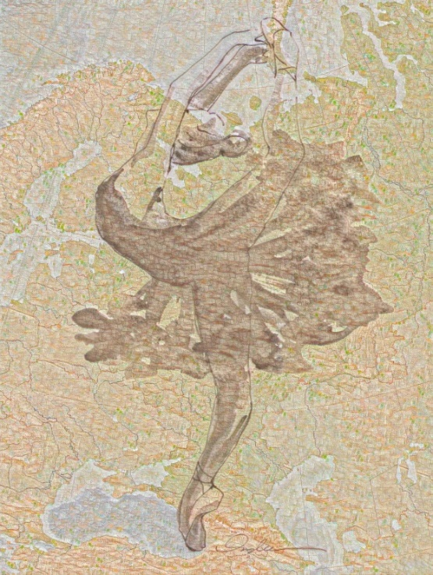
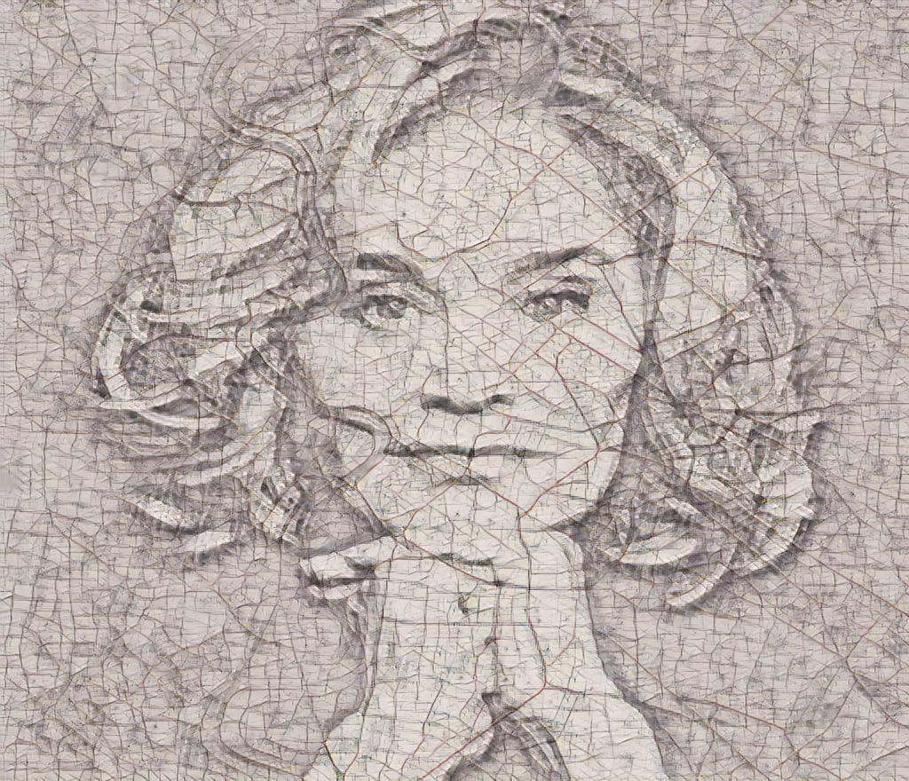
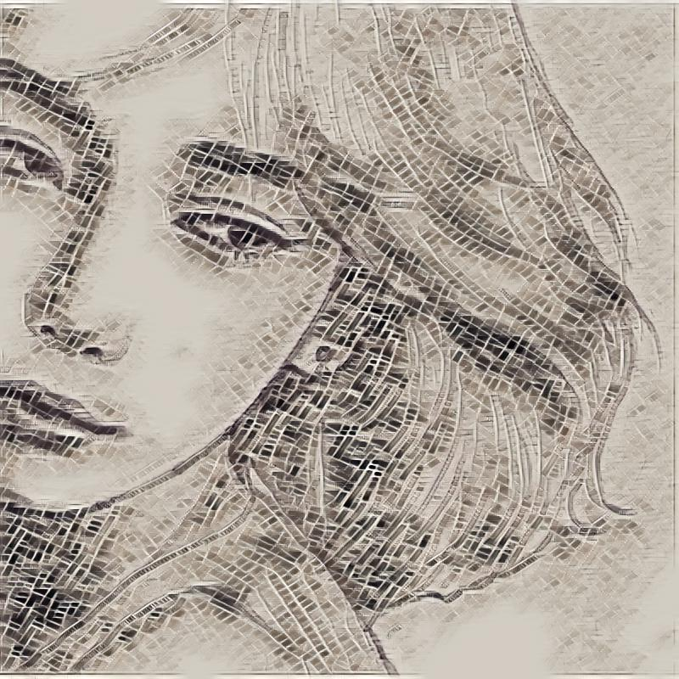
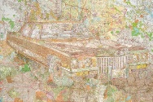
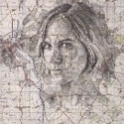
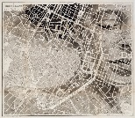
Map art style video transfer

Slide 3
Map art style video transfer
Why style transfer?

Slide 4
Map art style video transfer
Applications
Gaming
Commercial Art
Virtual Reality
Social Communication

Slide 5
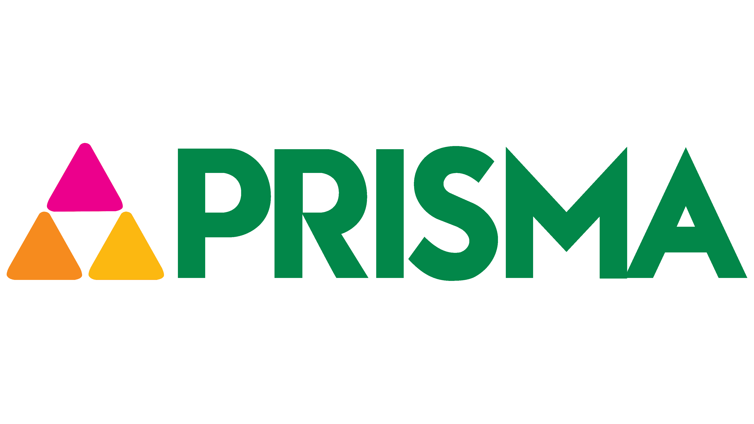
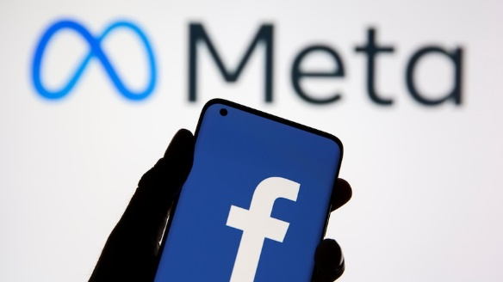
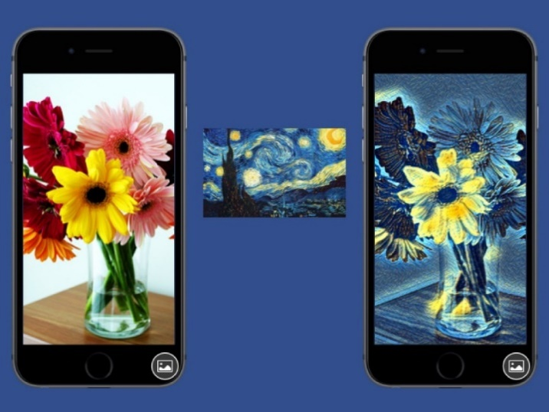
Style transfer application - Social communication
Notes:
One reason why NST catches eyes in both academia and industry is its popularity in some social networking sites.
Under the help of these industrial applications, people can create their own art paintings and share their artwork with others on Twitter and Facebook, which is a new form of social communication.
For example, Prisma, one of the first industrial applications that successfully provide NST as a service, is becoming popular around the world.

Slide 6
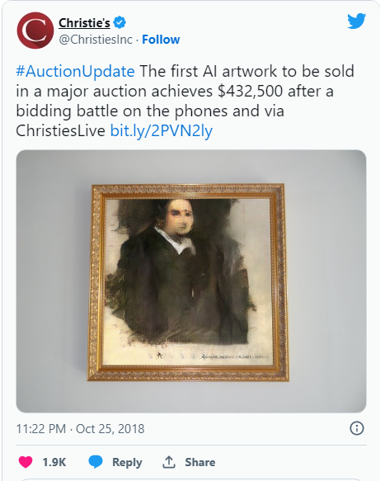
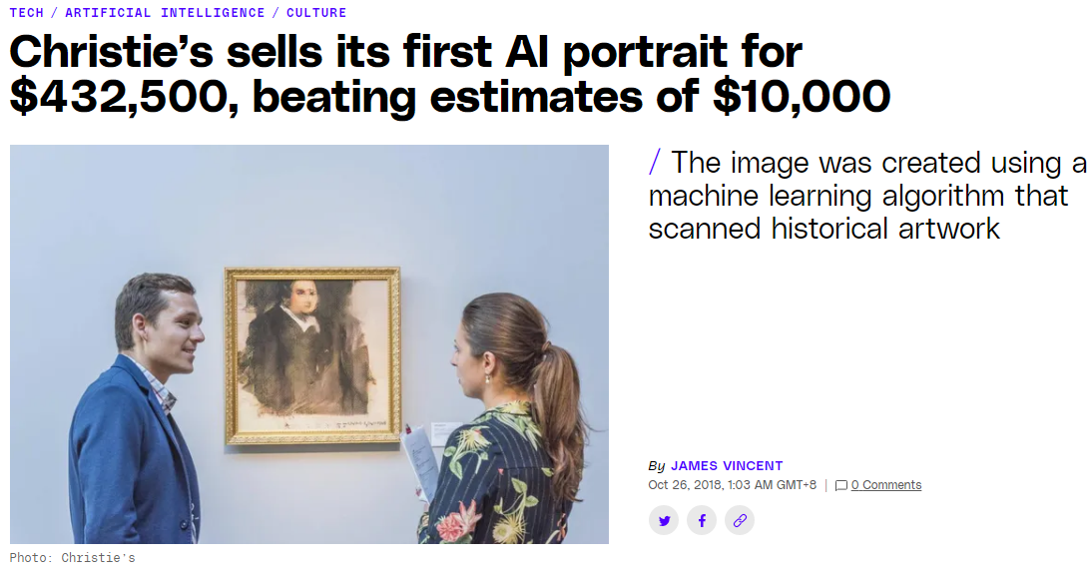
Style transfer application – Commercial art
Notes:
Christie’s has sold its first piece of AI art, a canvas named the Portrait of Edmond Belamy, for $432,500. The sale is unusual not only as a first for the 252-year-old auction house, but because the expected price for the print was between $7,000 and $10,000.

Slide 7
Style transfer application - Gaming
Notes:
At a press conference during the 2019 Game Developers Conference, one of the primary features included in that demo was an in-game style transfer feature that aauthomatically recomposes the virtual world with textures and color from a potentially limitless range of art styles.

Slide 8
Style transfer application – Virtual Reality
Notes:
Much like gaming, virtual reality also show what’s possible with style transfer.
And there are some early demos that show how style transfer could help augment the immersiveness of worlds created for virtual reality. Here’s one example.

Slide 9
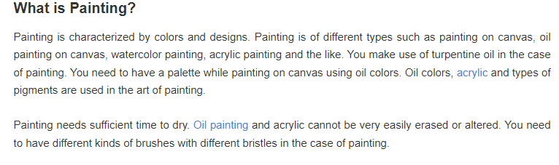
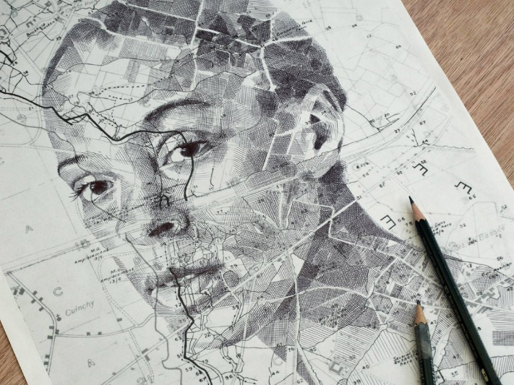
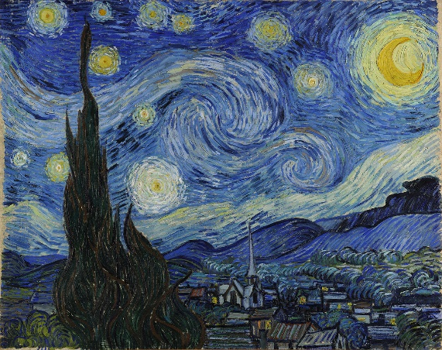
Painting vs Drawing

Slide 10
Map Art style
Map art is a masterpiece in which the artist integrates human portrait and topography to make it appear as though the two have always belonged together.
Source: Youtube
Notes:
This is such a modern art using pencil drawing that the artist try to preserver the functionality of map in each art work.

Slide 11
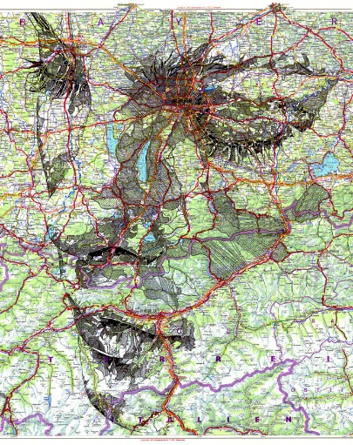
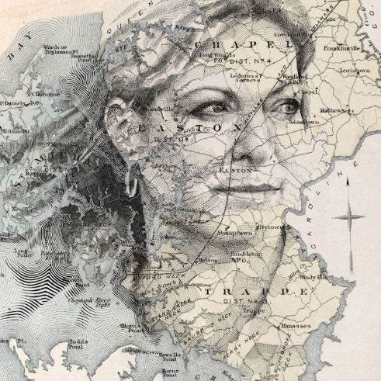
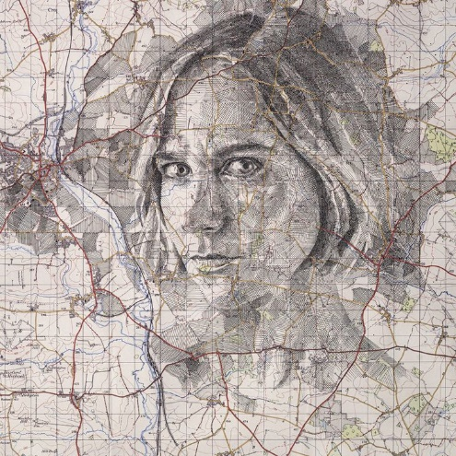
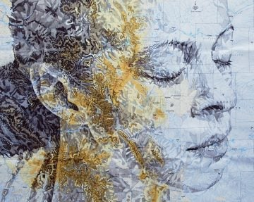
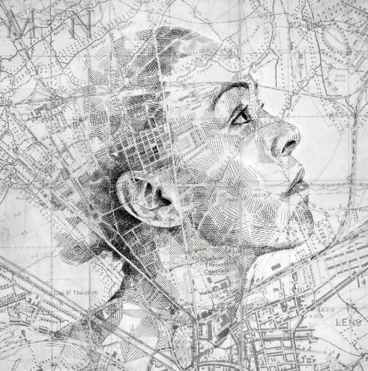
Map art style examples
Notes:
Here are some examples of map art.
The way that the artist integrates human portrait and topograph shape a new style.
Our goal is to build a network to learn this modern style and transfer it to video.

Slide 12
Video style transfer - Problem
Video style transfer by [Rude et al. 2016]
Notes:
To transfer a style of painting to video, so far, there are several research have introduced by different techniques. And here is an example.
The different here is the content video and the style of these painting are different from map art style.
For example, the content after stylization we can see they are leak.
That’s why, applying these method to video transfer with map art style is a challene.

Slide 13
Map art style transfer video - Problem
Challenges:
Preservation of map attributes.
Transfer the style of pencil drawing.
Avoid inconsistency.
Map art style sample
Notes:
Beside,

Slide 14
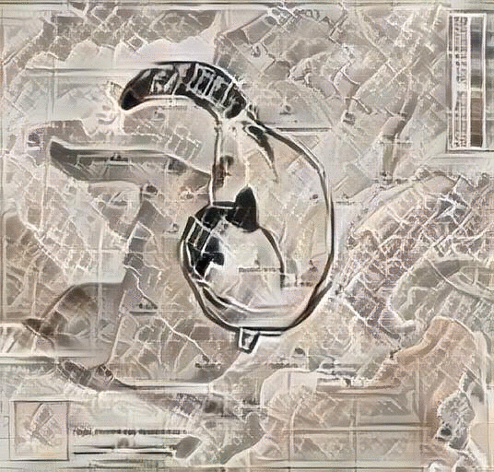
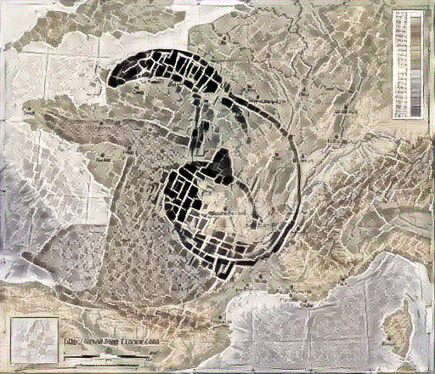
Map art style transfer video - Problem
[Johnson et al. 2016]
[Li et al. 2019]
[Zhang et al. 2019]
[Shih et al. 2021]
Designed for orinary image/video style transfer.
Lack of details/ semantics.
Lack of cohenrency of the content structure.
Not tailored to map content.

Slide 15
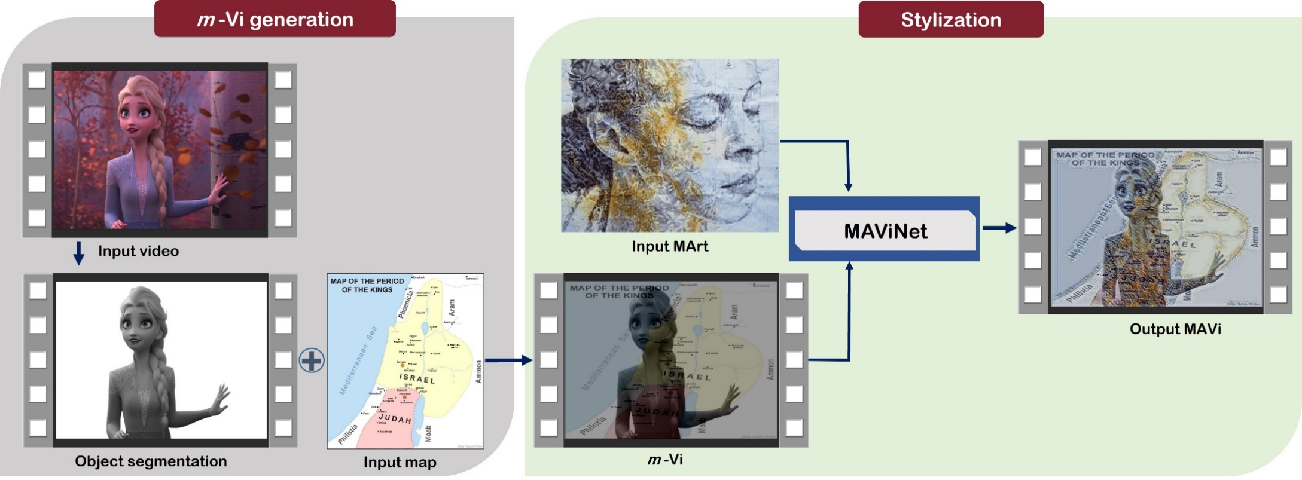
Map art style transfer video - Methodology

Slide 16
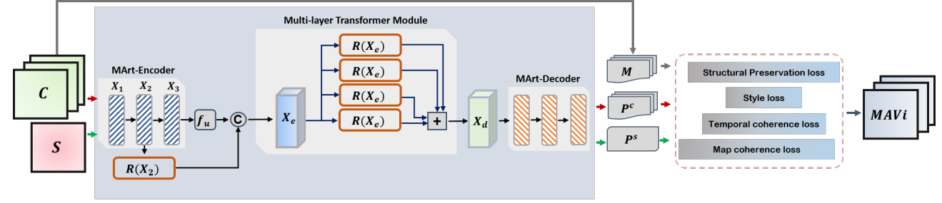
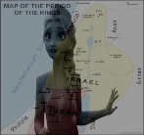
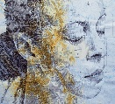
Map art style transfer video - Methodology
Notes:
This is the visualization of the structure of our network. Our network accepts a map art style image and a set of content frames. They are encoded by three Encoders.
In a standard architecture, we just simply add convolution layers to deepen the network to obtain deep features.
This way makes the gradient disappear, and the output images will become gradually blurry.
Previous research shows that residual networks are easier to optimize, and can gain accuracy.
That’s why we use residule block. However, …….
This way can help to understand the semantic-level which is required in stylization.

Slide 17
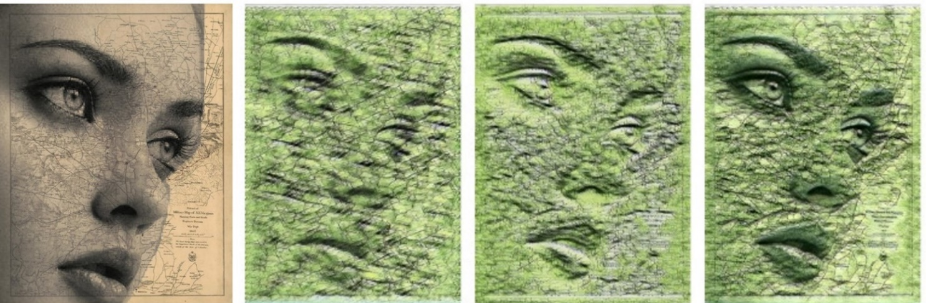
Ablated Results of MLT module
With plain
residual block
With MLT module
With convolution
layers
Notes:
Why we design MLT in the current application.
We can see that the plain encoder can generate results with color and patterns that are similar to the input style. However, attributes in the image is damaged, such as the eyes, eyebrows of the portrait or the map information is almost lost.

Slide 18
Loss function
Structural preservation
MArt style
Total variation
Coherence
Notes:
We train our network with 4 loss functions:
Structural preservation loss is to measure the semantic differences between the predicted frames and the input frames.
Mart style loss is to minimize the style differences between the generated frames and the input Map art.
The coherence loss is important, it’s responsible to guarantee the coherency of map structure and the temporal coherency in the stylzed video.
Finally is the total variation loss, similar to other works, we add this loss function to reduce the noise on the generated frames.

Slide 19
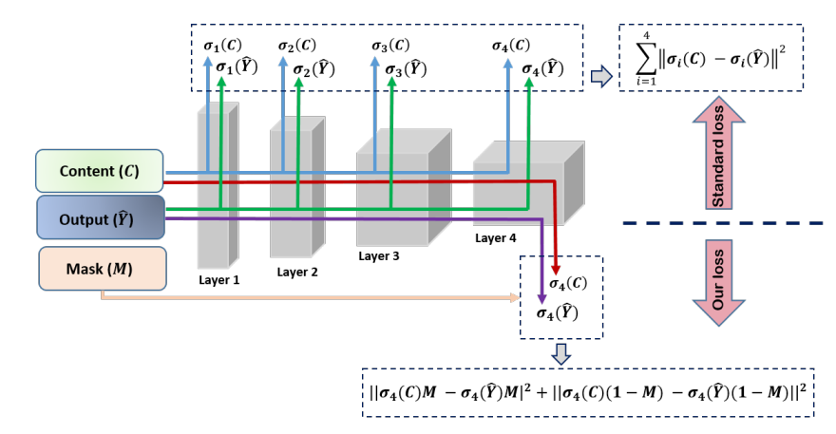
Structural preservation loss
Structural preservation
Background Preservation $𝓛_{b}$
Foreground Preservation $𝓛_{f}$
Notes:
We design the structural preservation loss with two terms, L_b and L_f.
Here M is the ground-truth mask of the input content frame.
The reason for this formulation is that ….
Let’s see what makes it different from the normal way that most of the works in style transfer use in the content loss. Similar to these work, we also use four layers of a pre-trained model (VGG is used here).
However, …..

Slide 20
Ablated results of structural preservation loss
Input
Without $ℒ_{SP}$
With $ℒ_{SP}$

Slide 21
MArt style loss
Notes:
For the style loss, previous works often use Gram matrix
And Compute MSE loss between gram matrix of input and the style image Compute MSE loss between gram matrix of input and the style image .
In our style loss, we also use feature maps of five layers in VGG, however, we detach it into two functions.
We use layers conv4 and conv5 to retain the texture of the map art style.
And the first three layers are computed by cross-layer gram matrix to reduce their impact on the results.

Slide 22
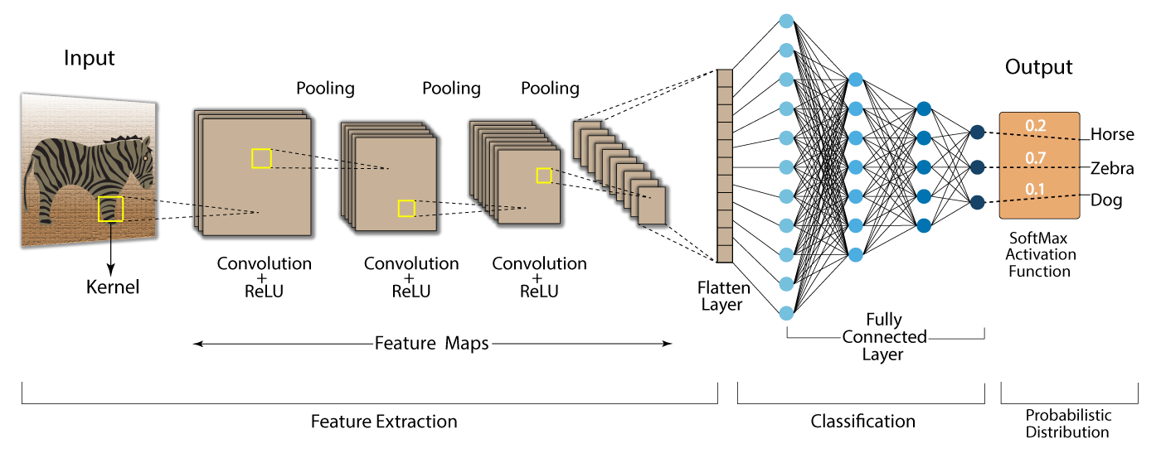
MArt style loss
Sensitive to content
Sensitive to style
Source image: Internet
Notes:
We detach the loss function into two because in a CNN structure, the first layers are sensitive to content, and the later layers are sensivtive to style.

Slide 23
MArt style loss
Notes:
For the style loss, previous works often use Gram matrix
And Compute MSE loss between gram matrix of input and the style image Compute MSE loss between gram matrix of input and the style image .
In our style loss, we also use feature maps of five layers in VGG, however, we detach it into two functions.
We use layers conv4 and conv5 to retain the texture of the map art style.
And the first three layers are computed by cross-layer gram matrix to reduce their impact on the results.

Slide 24
Ablated results of MArt loss
Map art style
Standard style loss
Our style loss
Notes:
Besides, Map art is a kind of pencil drawing, it’s challenging to eliminate the noise caused by this kind of medium.
For example we can see here, black-square noises appear on the results if we use the standard style loss.

Slide 25
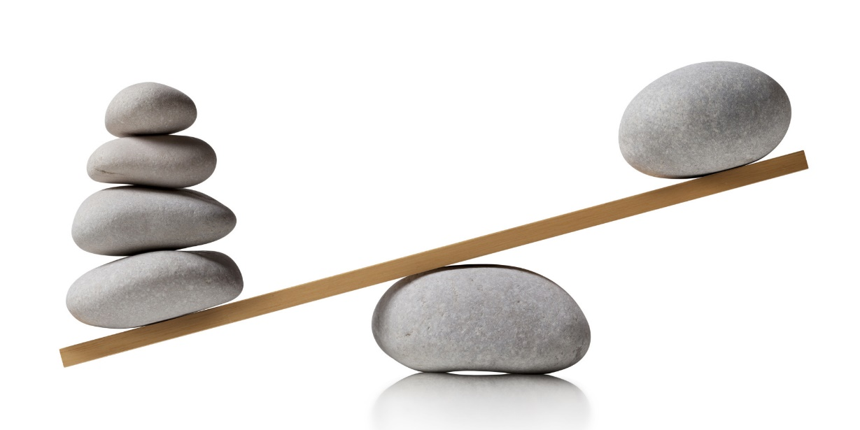
Coherence loss
Coherence Loss
Map coherency $ℒ_{m}$
Temporal coherency $ℒ_{t}$
Style
Temporal coherency
Notes:
We formulate the coherence loss consisting of two components, map coherency (i.e., L_m) and temporal coherency (i.e., L_t)
So, why we need this formulation?
There is a trace-off between performance of style and temporal consistency.
Previous works indicate that if we force to maintain the temporal, then the stylization performance will degrade.
That’s why although some models are temporally smoother, the distribution of color is simple, and the details of strokes and textures are lost.

Slide 26
Coherence loss – Temporal coherency
$$C_{t−1}$$
$${\hat{Y}}_{t−1}$$
$$C_{t}$$
$${\hat{Y}}_{t}$$
Ground truth
Occlusion map
& Optical flow
Predicted
Notes:
.
Map coherence loss is used to preserve the integrity of map after transferring to a new style.
For the coherency in our application, we consider the coherency not only in temporary but also in map structure.

Slide 27
Coherence loss – Map coherency
$$C_{t−1}$$
,
$$C_{t}$$
,
vs
$${\hat{Y}}_{t−1}$$
$${\hat{Y}}_{t}$$
,
,

Slide 28
Ablated results of coherency map
Mart style
Content
Without $ℒ_{m}$
With $ℒ_{m}$

Slide 29
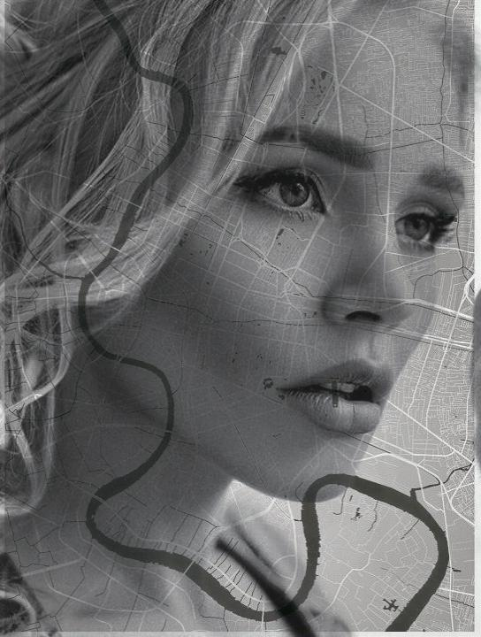
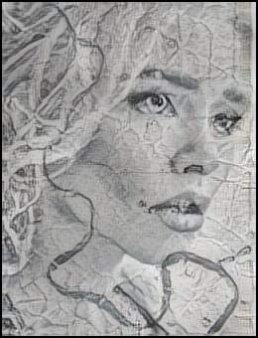
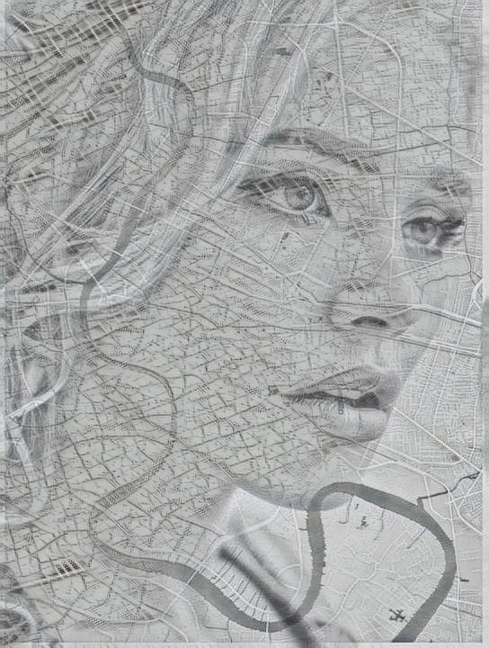
Experimental Results
Input
[Li et al. 2019]
[Zhang et al. 2019]
Ours

Slide 30
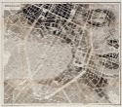
Experimental Results
Input
[Johnson et al. 2016]
Ours
Notes:
Competition on video,
Discuss about the color of style, map attributes, flickering artifact

Slide 31
Experimental Results
Input
Stylized by our method

Slide 32
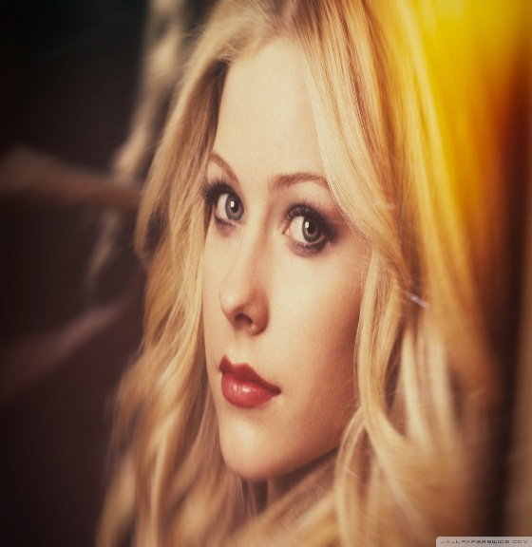
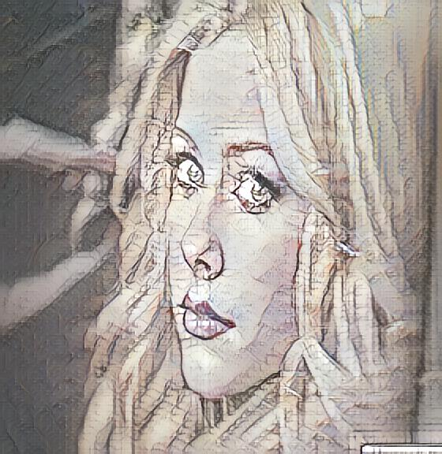
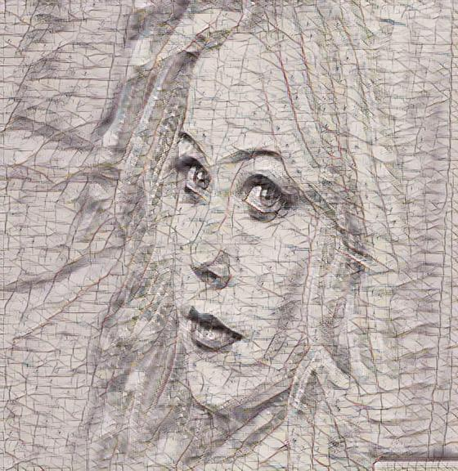
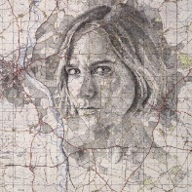
Experimental Results
Input
[MCCNet]
Ours
[MCCNet] Yingying Deng, Fan Tang, Weiming Dong, Haibin Huang, Chongyang Ma, and Changsheng Xu. 2021. Arbitrary video style transfer via multi-channel correlation. In Proceedings of the AAAI Conference on Artificial Intelligence.1210–1217

Slide 33
Explore more at project website
http://graphics.csie.ncku.edu.tw/MArtVi

