Slide 1
CGW2019

Slide 2
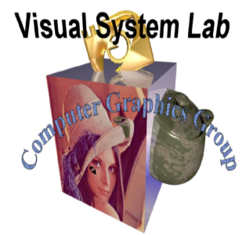
Computer Graphics Group of Visual System Lab at
Dept. of Computer Science and Information Engineering,
National Cheng – Kung University
Visit us at: http://graphics.csie.ncku.edu.tw

Slide 3
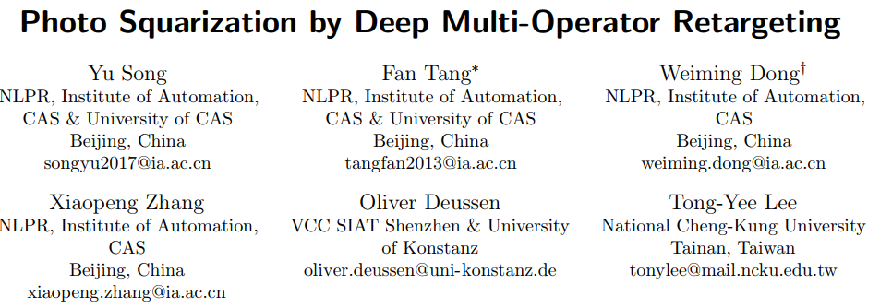

Slide 4
Outline
Introduction
Problem
Dataset
Formulation
Our approach
Structure in our learning approach
Data collection
Modules in our framework
Our approach
Our results

Slide 5
1. Introduction

Slide 6
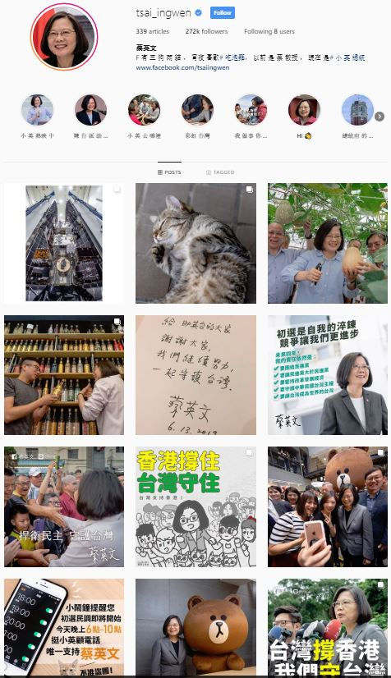
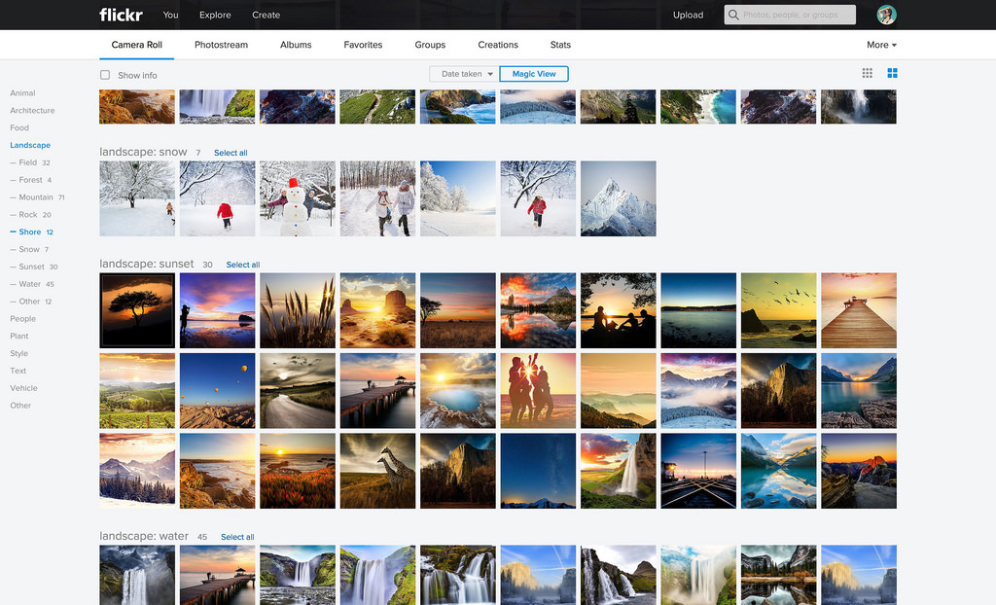
1. Introduction
Standard operation is cropping

Slide 7
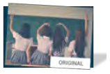
1. Introduction
Content-aware image retargeting (CAIR) methods

Slide 8
1. Introduction
Content-aware image retargeting (CAIR) methods
Most methods are developed by following one single scheme, thereby leading to adaptability problem on general displaying use for social media

Slide 9
1. Introduction
Multi – operator methods
CAIR
Seam carving
Scaling
Cropping
Contents + compositions

Slide 10
1. Introduction
Acquiring user preference information for retargeting a photo to square
Challenges
Understand human behavior in balancing
three issues:
salient content, object shape, scene composition
Square shape
Predicting squarization strategy that is consistent with human visual perception
Three mentioned issues: Retargeting Visual Perception Issues (RVPIs)

Slide 11
1. Introduction
Acquiring user preference information for retargeting a photo to square
Challenges
Build a synergy
RVPIs
Square shape
CAIR
Predicting squarization strategy that is consistent with human visual perception

Slide 12
2. Dataset

Slide 13
2. Dataset 2.1. Perception Formulation
Salient content
Object shape
Scene composition
Retargeting Visual Perception Issues (RVPIs)
balance
Salient content | Seam carving | $$R_{sc}$$ | Seams are carved out
Object shape | Cropping | $$R_{cr}$$ | Columns are cropped
Scene composition | Scaling | $$R_{sl}$$ | Image is scaled by $R_{sl}$pixels
Given a photo $T$ define [$R_{sc}$, $R_{cr}$, $R_{sl}$] as the operation allocation performed on one dimension of I to obtain a square image $T$

Slide 14
2. Dataset 2.2. Data Collection
5.084 images collected on the basic of 3 principles:
Popularity
Collect from Flickr, Pinterest, Pexels
2. Comprehensive
Images from “RetargetMe”
3. Operability
Duplicate images and images with too large or too small aspect ratio → picked out
Each participant square all 5.084 images
by allocating the three operators

Slide 15
3. Our approach

Slide 16
3. Approach

Slide 17
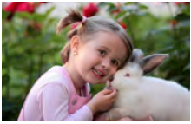
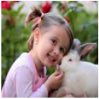
3. Approach 3.1. Problem Formulation
Square
Size (w, h)
Size (t, t);
t = min(w, h)
Learning the mapping function $f:f\left(I\right) →r ∈ R^{3}$
Where $r=[ r_{sc}= \frac{R_{sc}}{R},r_{cr}= \frac{R_{cr}}{R},r_{sl}= \frac{R_{sl}}{R}]$
$R_{sc}+ R_{cr}$ + $R_{sl}=R$
$$R=\max\left(w, h\right)−t$$
Learning goal

Slide 18
3. Approach 3.1. Problem Formulation

Slide 19
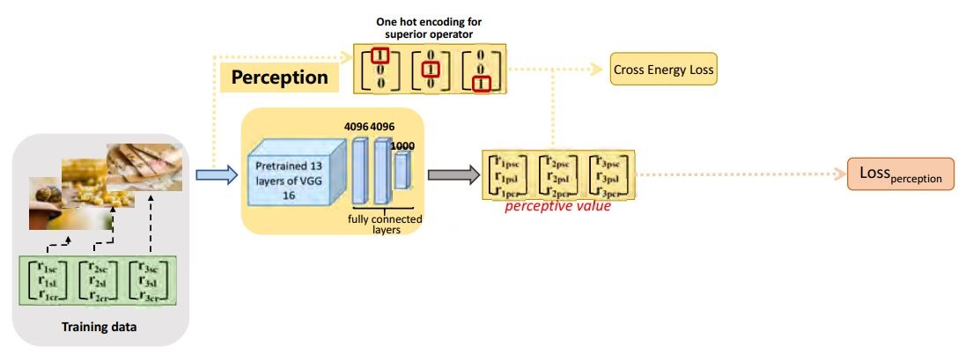
3. Approach 3.2. Learning approach
Perception module
Learn the relationship among the three kinds of operations
Distillation module
Soft target
output
Mapping the original image and perceptive value
$$r_{p}$$

Slide 20
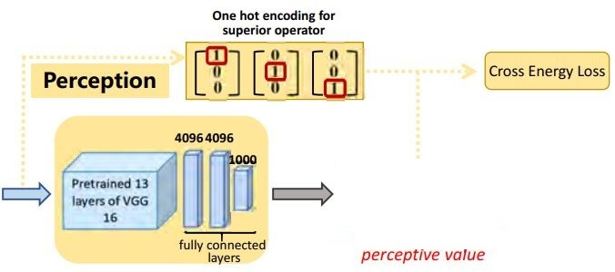
3. Approach 3.2. Learning approach
$$\left[\begin{aligned}r_{psc}^{} \\ r_{pcr}^{} \\ r_{psl}^{}\end{aligned}\right]$$
output

Slide 21
3. Approach 3.2. Learning approach
Distillation module
Transfer the output of the perception module ($r_{p})$to distillation module.
$$\left[\begin{aligned}r_{psc}^{} \\ r_{pcr}^{} \\ r_{psl}^{}\end{aligned}\right]$$
Output
of perception module
Input image
$$r=[r_{sc},r_{cr},r_{sl}]$$
Loss functions:
$Loss\left(r^{∗}, r_{p},r\right)= {Loss}_{perception}(r^{∗}, r_{p})$ + $δ. {Loss}_{target}$($r^{∗}, r$)
Learn the transferring $r_{p}$
The offset between input label $r$ and output $r^{∗}$

Slide 22
4. Results

Slide 23
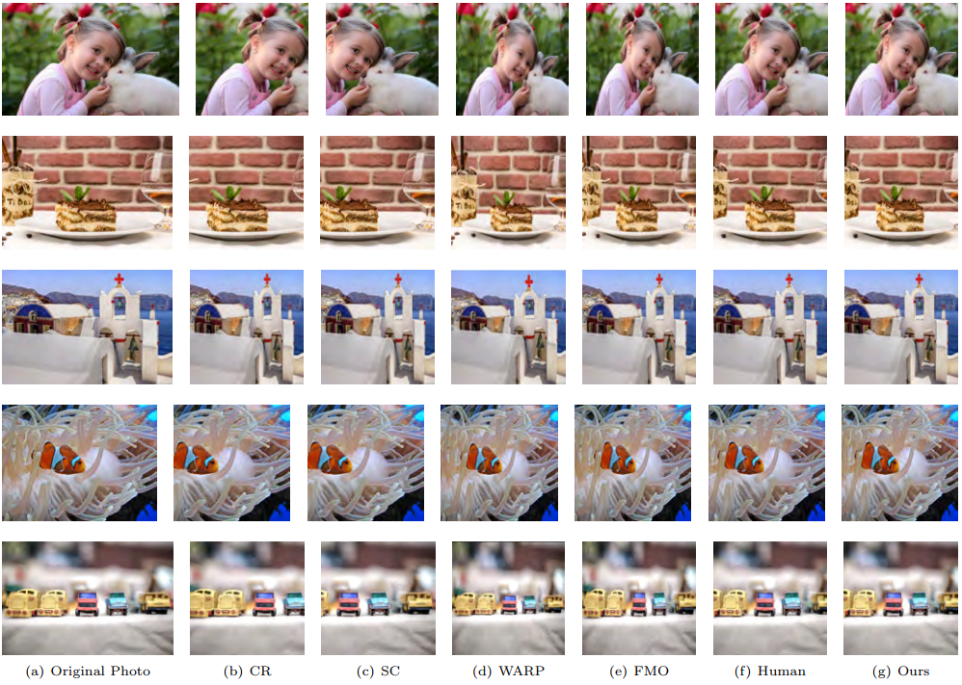
Comparison of our results with those of other state-of-the-art methods for transverse images

Slide 24
Comparison of our results with those of other state-of-the-art methods for longitudinal images

Slide 25
Conclusion
Our work makes the following technical contributions:
1. A new way to observe human perception preferences among RVPIs during photo squarization process.
2. A new dataset with annotations that indicates user preferences toward photo squarization problem
3. A new two-module deep neural network for learning user preferences and predicting retargeting operations for photo squarization.

Slide 27
Thanks for your listening

Slide 28
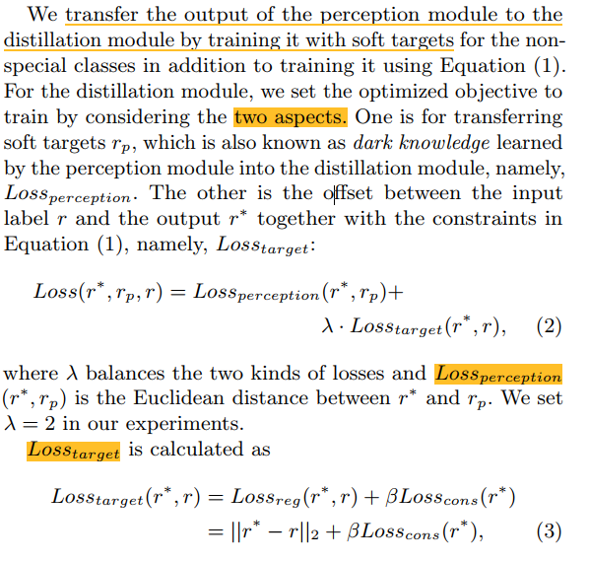
Appendix

